Slide 1
Supply Chain Management Unit 2 – Logistics strategy
Venkadeshwaran K
Associate Professor
School of Mechanical Engineering
FET, JAIN (Deemed to be University)

Slide 2
Syllabus
Planning the Supply Chain: Logistics strategy- strategy options, designing a logistics strategy, Implementation - Relating Strategy to Lower Decisions - Areas for Decisions in Implementation - Managing Change

Slide 3
Learning Objectives
After learning this chapter, you should be able to:
See how a logistics strategy fits into an organization’s broader decisions.
Outline the strategic importance of logistics
Define a logistics strategy and discuss its focus
Discuss alternative logistics strategies
Approach the design of a logistics strategy

Slide 4
Strategic Decisions
Decisions are classified by:
Strategic decisions: the most important decisions and set the overall direction of the organization. They have effects over the long term.
Tactical decisions: implementing the strategies over the medium term. They look at more detail.
Operational decisions: the most detailed and concern activities over the short term.

Slide 5
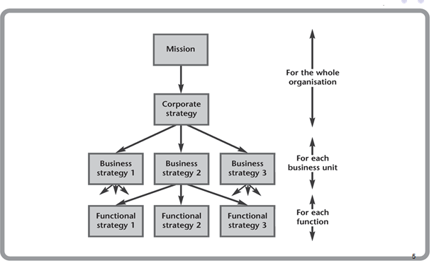
Strategic Decisions
Types of strategic decisions

Slide 6
Strategic Decisions
Mission: a statement to give the overall aims of the organization.
Corporate strategy: shows how a diversified corporation will achieve its mission.
Business strategy: shows how each business within a diversified corporation will contribute to the corporate strategy.
Functional strategies: describe the strategic direction of each function, including logistics.

Slide 7
Logistics Strategy
Logistics strategy consists of all the strategic decisions, policies, plans and culture relating to the management of its supply chains.
The logistics strategy forms a link between the more abstract, higher strategies and the detailed operations of the supply chain.
While the corporate and business strategies describe general aims, the logistics strategy concerns the actual movement of materials needed to support these aims.
The higher strategies set the context for the logistics strategy.
Logistics managers do not simply respond to this context, they actively contribute to its formulation.

Slide 8
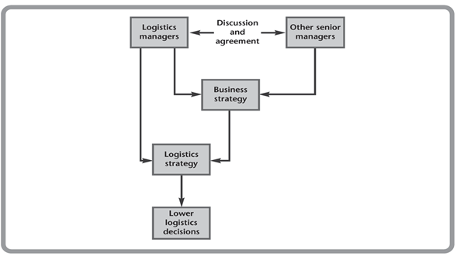
Logistics Strategy
Role of Logistics Managers in Strategic Decision

Slide 9
Focus of Logistics Strategy
A logistics strategy is most likely to emphasize the following:
Cost: lower costs lead to higher profits for organization and lower prices for customers.
Customer service: logistics controls stock levels, delivery times, speed of response, and so on. This strategy allows organizations to get a long-term competitive advantage.
Timing: it mean rapid supply of new products, or delivering at the time specified by a customer. A common logistics strategy guarantees fast deliveries.

Slide 10
Focus of Logistics Strategy
Quality: a common logistics strategy guarantees high quality service to satisfy customers.
Product flexibility: one logistics strategy is based on a specialized or customized service to individual specifications.
Volume flexibility: it allows an organization to respond quickly to changing levels of demand.
Technology: a logistics strategy can be focused on the development and use of the latest technologies for communications, tracking loads, identifying product, recording stock movements and so on.
Location: one logistics strategy is to provide a service in the best possible location since customers generally want products to be delivered as close to them as possible.
11

Slide 11
Focus of Logistics Strategy
In principle, organizations should do everything well, giving low cost, good customer service, fast delivery, flexibility, using high technology, and so on.
In practice, this is unrealistic.
Organizations have to compromise, perhaps balancing the level of service with the cost of providing it.
Effectively they choose a specific focus for their logistics strategy, showing which factor they consider to be most important.

Slide 12
Strategy Option
Michael Porter suggested two basic strategies:
Cost leadership: makes the same, or comparable, products more cheaply.
Product differentiation: makes products that customers cannot get from other suppliers.
Example:
Lyons Bakeries compete by cost leadership, selling standard cakes at low prices.
La Patisserie Française competes by product differentiation, selling cakes that are not available anywhere else.
EasyJet competes by cost leadership, offering the cheapest fares. Execujet compete by offering a uniquely luxurious service.

Slide 13
Strategy Option
In logistics, these two approaches are usually phrased in terms of lean and agile strategies.
Organisations with a focus on lean logistics are aiming at low costs;
those with a focus on agile logistics are aiming at high customer satisfaction.

Slide 14
Lean Strategies
Lean strategy is aimed at low costs. It is to do every operation using less of each resource (people, space, stock, equipment, time, etc.).
Therefore, lean logistics is aimed at minimizing the total cost of logistics.
One warning is that. low costs do not automatically mean lean operations
Lean operations maintain customer service while using fewer resources – they do not just minimize costs.

Slide 15
Lean Strategies
Five main principles:
Value: designing a product that has value from a customer’s perspective.
Value stream: designing the best process to make the product.
Value flow: managing the flow of materials through the supply chain – getting an efficient flow of materials, eliminating waste, interruptions, waiting and detours.
Pull: only making products when there is customer demand
Aim of perfection: looking for continuous improvements to get closer to the aim of perfect operations.

Slide 16
Lean Strategies
Robert Townsend says that, ‘All organisations are at least 50% waste – waste people, waste effort, waste space and waste time’.
During their development work, Toyota identified the following areas of the supply chain where this waste is most likely to occur:
Quality – that is too poor to satisfy customers (either external or internal).
Wrong production level or capacity – making products, or having capacity, that is not currently needed.
Poor process – having unnecessary, too complicated or time-consuming operations.

Slide 17
Lean Strategies
Waiting – for operations to start or finish, for materials to arrive, for equipment to be repaired, and so on.
Movement – with products making unnecessary, long, or inconvenient movements during operations.
Stock – holding too much stock, increasing complexity and raising costs.
A lean strategy looks for ways of eliminating this waste. One warning is that low costs do not automatically mean lean operations.

Slide 18
Agile Strategy
The aim of an agile strategy is to give a high customer service by responding quickly to different or changing circumstances.
Two aspects of agility:
There is the speed of reaction; agile organizations keep a close check on customer demands and react quickly to changes.
It is the ability to tailor logistics to demands from individual customers.
Organizations that put a lot of emphasis on customer satisfaction are said to have a customer focus

Slide 19
Agile Strategy
Organisations with a customer focus will typically:
aim for complete customer satisfaction
allow customers easy access to the organisation
find exactly what they want
design logistics to meet, or exceed, these demands
be flexible and respond quickly to changing customer demands
get a reputation for outstanding quality and value
do after-sales checks to make sure the customers remain satisfied
look outwards so that they are always in touch with customers, potential customers, competitors, and so on.

Slide 20
Agile Strategy
Organisations with satisfied customers have the obvious benefit of bringing them back with repeat business – remembering the rule of thumb that it costs five times as much to attract a new customer as it does to retain an existing one.
Satisfied customers also attract new business, as they recommend a good service to four or five other people – compared with dissatisfied customers who warn a dozen potential customers about a bad experience.

Slide 21
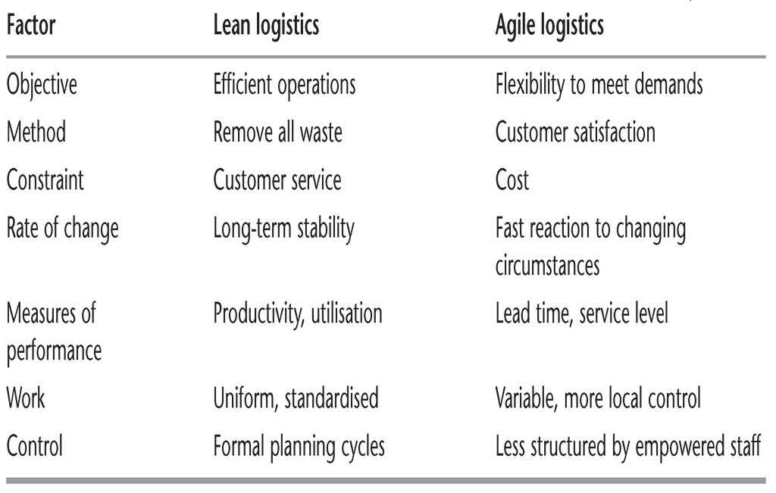
Lean versus Agile

Slide 22
Strategic Alliances
The purpose of this strategy is to get efficient supply chains, with all members working together and sharing the benefits of long-term cooperation.
A strategy of forming partnerships allow for better customer service, increased flexibility, reduced costs, avoidance of investment in facilities, and lack of expertise within the organization.
Some common areas for partnerships is transport, warehousing, import/export services, materials storage, and so on.

Slide 23
Other Strategies
Time-based strategies: aim for a guaranteed faster delivery of products. Benefits include:
Lower costs by having less stock in the supply chain
Improved cash flow by not having to wait so long for payment
Less risk by reducing changes to orders, obsolete stock,…
Simpler operations by eliminating delays and unnecessary stores.
But faster logistics may reduce the quality.

Slide 24
Carter et al.16 discuss seven ways of reducing time:
1. simplification – making operations simpler
2. integration – improving information and material flows
3. standardisation – using standard procedures and materials
4. concurrent operations – moving away from serial operations and towards parallel working
5. variance control – ensuring high quality and avoiding waste
6. automation – to improve effectiveness and efficiency
7. resource planning – to remove bottlenecks and ensure a smooth flow of materials.

Slide 25
Other Strategies
Environmental protection strategies: a small, but increasing, number of organization are developing strategies based around environmental protection.
The principles in logistics are to use reusable containers and recycling of materials.
Most organizations assume that “going green” raises costs.
Only 19% of companies reported a logistics environmental policy. In a survey conducted in UK 1993
In reality, many programs for environmental protection reduce costs. Ex: insulation of warehouses, regular maintenance of road vehicles…

Slide 26
Other Strategies
Increased productivity strategies: aim for using available resources as fully as possible.
Ex: facilities (e.g. warehouses) have high fixed costs and using them at full capacity spreads these costs over more units. Imagine a facility that is working at 60% of capacity. Obviously, there is spare capacity that is raising unit costs.
The lean approach would look for ways of removing the 40% spare capacity – and then continue looking for further reductions over time.
A high productivity strategy is more likely to accept the present capacity, and starts looking for alternative uses for the excess. An office or warehouse might rent out space.

Slide 27
Other Strategies
Valued-added strategies: aim for adding as much value as possible to final products.
Organizations can add value by adding time and place utility, or doing more work on the product.
Ex: a company delivers washing machines to customers’ houses. It adds value by delivering to the place and at the time preferred by customers, or by doing more work such as installing the machines, testing them, giving instructions on their use, removing old machines, offering service contracts, and so on.

Slide 28
Other Strategies
Diversification or specialization strategies: look at the range of services offered by logistics.
Some organizations have strategies of diversification, offering the widest range of services and satisfying as many customers as possible. Ex: a department store which sells every product; some transport companies move every kind of load from letters through to oversize loads.
Other organizations have a strategy of specializing in a very narrow range of services, but being the best provider in their chosen area. Ex: some transport companies move only small packages with high security.

Slide 29
Designing a Logistics Strategy
Example:
Our mission in logistics is to contribute to corporate aims by moving the materials needed by production into the company, moving work in progress through the company, and moving finished products out to customers. We aim to give a flexible, reliable and cost effective service that completely satisfies our customers, both internal and external.

Slide 30
Designing a Logistics Strategy
Organisations tend to be ambitious and include aims of being ‘acknowledged leaders’, ‘the best’, ‘world class’, and so on. Smith19 says that such flowery statements fail in three ways.
First, they are over-ambitious, setting targets that the organisations cannot realistically achieve.
Second, they are so vague that no one can tell whether the mission is actually being achieved or not.
Third, they miss the opportunity of using a powerful tool that can really help manage the logistics.

Slide 31
Designing a Logistics Strategy
There are three factors to consider when designing a logistics strategy:
the higher strategies
the business environment
the organization’s distinctive competence

Slide 32
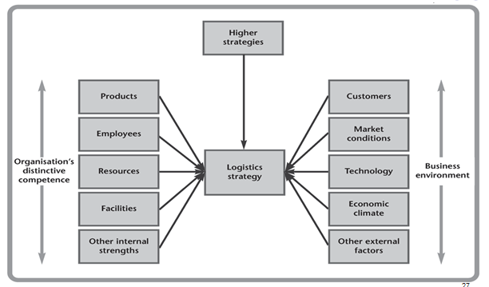
Designing a Logistics Strategy
Factors in the Design of a Logistics Strategy

Slide 33
Designing a Logistics Strategy
Higher Strategies
Higher strategies set the organization’s goals and the context for all logistics decisions.
The mission sets the overall aims, and the corporate and business strategies show how these aims will be achieved.
The logistics strategy must support these higher strategies. If, for example, the business strategy calls for high customer service, the logistics strategy must show how logistics will achieve this.

Slide 34
Designing a Logistics Strategy
Business Environment
The business environment consists of the factors that affect logistics, but over which it has no control. These include:
customers – their expectations, attitudes, demographics
market conditions – size, location, stability
technology – current availability, likely developments, rate of innovation
economic climate – gross domestic product, growth rate, inflation
legal restraints – trade restrictions, liability and employment laws

Slide 35
Designing a Logistics Strategy
Business Environment
competitors – number, ease of entry to the market, strengths
shareholders – their target return on investments, objectives, profit needed
interest groups – their objectives, strengths, amount of support
social conditions – customers’ lifestyles, changing demands
political conditions – stability, amount of governmental control, external relations.

Slide 36
Designing a Logistics Strategy
Organization’s Distinctive Competence
A distinctive competence stems from an organization’s assets, which include:
customers – their demands, loyalty, relationships
employees – skills, expertise, loyalty
finances – capital, debt, cash flow
organization – structure, relationships, flexibility
products – quality, reputation, innovations
facilities – capacity, age, reliability
technology – currently used, plans, special types

Slide 37
Designing a Logistics Strategy
Organization’s Distinctive Competence
processes – structures, technology used, flexibility
marketing – experience, reputation
suppliers – service, flexibility, partnerships
other assets – knowledge, innovation, patents.

Slide 38
Designing a Logistics Strategy
In short:
the business environment and distinctive competence show where an organization is now.
the higher strategies show where it wants to be in the future.
the logistics strategy shows how to move from one to the other.

Slide 39
Logistics Audit
The purpose of a logistics audit is to collect relevant information about existing practices and performance of logistics.
We have details of current performance from the audit.

Slide 40
Logistics Audit
Two main parts to a logistics audit:
Getting information about business environment (external audit): the nature of customers, types of demand, accepted service levels, competitors and their operations, benchmarks and comparisons, economic conditions, geographical and political constraints, and other relevant external information.
Getting information about distinctive competence of organization (internal audit): the structure of the supply chain, warehouse locations and size, stock holdings, lead times, order processing, damage, productivity, and other relevant internal information.

Slide 41
Logistics Audit
This approach is similar in principle to a SWOT analysis, which lists an organization’s strengths, weaknesses, opportunities, threats.
We know where we want to go from a logistics mission, and where we are at the moment from the logistics audit.
The next stage is to identify gaps between these two and show how to bridge the gaps.

Slide 42
Developing the Strategy
There are eight steps for designing a strategy:
The external audit gives an analysis of the business environment and then shows the factors that lead to success in this environment.
The internal audit analyses higher strategies from a logistics viewpoint, giving the context and overall aims for logistics, its strategic focus and perhaps includes a logistics mission.

Slide 43
Developing the Strategy
Design the general features of supply chains that can best deliver the desired services. This includes the design of the network, location of facilities, capacity, technology used, and so on.
Set specific goals to show what each logistics activity must achieve. The internal audit shows how well the current logistics achieve these goals, and identifies areas that need improving.
Design the best organizational structure, controls and systems to support the logistics network.

Slide 44
Developing the Strategy
Benchmark logistics, looking at the performance of leading organizations, defining measures to compare actual performance with planned, optimal and competitors’ performances.
Implement the strategy, setting the conditions for lower levels of logistics decisions.
Monitor actual performance, continually look for improvements, keep the strategies up to date, and give feedback.

Slide 45
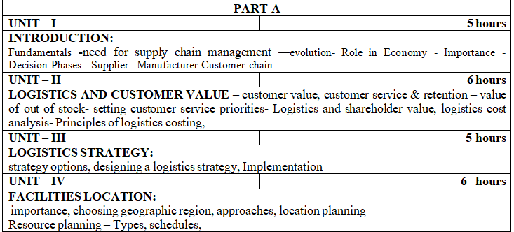
Syllabus

Slide 46
Implementing the Strategy
DESCRIBE the steps involved in implementing a logistics
strategy
APPRECIATE the problems of implementation
CONSIDER the decisions needed for implementing the
logistics strategy
RECOGNISE the importance of continual change in the
supply chain
DISCUSS the management of change, particularly the rate of
change

Slide 47
Implementing the Strategy
last section we looked at the design of a logistics strategy (long-term decisions, policies, plans and culture relating to logistics)
They have to answer questions such as:
How does the strategy affect the logistics network?
Should we change our warehouse and transport operations?
Will our approach to planning and scheduling change?
Do we have, or can we get, the necessary resources?
Do we have, or can we train, people with the necessary skills?
How will the strategy affect present and potential customers?
What are the impacts on staff, facilities, organisation, technology, and so on?

Slide 48
Implementing the Strategy
A strategic decision to sell products through a website leads to medium-term tactical decisions about warehousing, investment in stock, transport, materials handling, recruiting and training, customer service, and so on.
These tactical decisions, in turn, lead to short-term operational decisions about resource scheduling, inventory control, expediting, vehicle routes, and so on.
The distinctions between strategic, tactical and operational decisions are not really this clear.

Slide 49
Implementing the Strategy
Inventory, for example, is a strategic issue for decisions about building a warehouse for ﬁnished goods or shipping directly to customers, a tactical issue when deciding how much to invest in stock, and an operational issue when deciding how much to order this week.
Customer service is a strategic issue when designing the supply chain, a tactical issue when organising transport for delivery, and an operational issue when scheduling the next delivery.
The important point is to recognise that the strategy leads to a whole series of related decisions at different levels. What you call these levels and where you draw the boundaries is a matter of convenience.

Slide 50
Implementing the Strategy
Strategies only become effective when they are IMPLEMENTED.
This means that the long-term aims are translated into lower decisions, and the work is carried out to achieve them.
difﬁcult to translate a logistics strategy into lower decisions- when the strategy is poorly designed, and lower managers have to translate vague concepts like ‘global leadership’ into actual operations.

Slide 51
Difﬁculties with implementation
The following list gives some common problems with implementing logistics strategies:
people who design the strategies are not responsible for their implementation
strategies are badly designed, perhaps with the wrong aims or focus, it is impossible, or very difﬁcult, to implement them properly
they do not take enough account of actual operations, perhaps because there were not broad enough discussions
they are over-ambitious, or somehow not realistic
they ignore key factors, or emphasise the wrong features
people only pay lip-service to supporting the strategies
enthusiasm for the strategies declines over time.

Slide 52
Difﬁculties with implementation
One surprisingly common mistake is to design a logistics strategy and then think about implementing it.
The obvious way to avoid this is to think about implementation all the way through the design, and always consider the practical effects of any policies.

Slide 53
Factors that help devise a strategy that can be used are:
an organisational structure that is ﬂexible and allows innovation
formal procedures for translating the strategy into reasonable decisions at lower levels
effective systems to distribute information and support management decisions
open communications which encourage the free exchange of ideas

Slide 54
Factors that help devise a strategy that can be used are:
acceptance that strategies are not ﬁxed, but continue to evolve over time
control systems to monitor progress
convincing everyone that the strategy is beneﬁcial, so they conscientiously play their part in implementation
developing an organisational culture that supports the strategy.

Slide 55
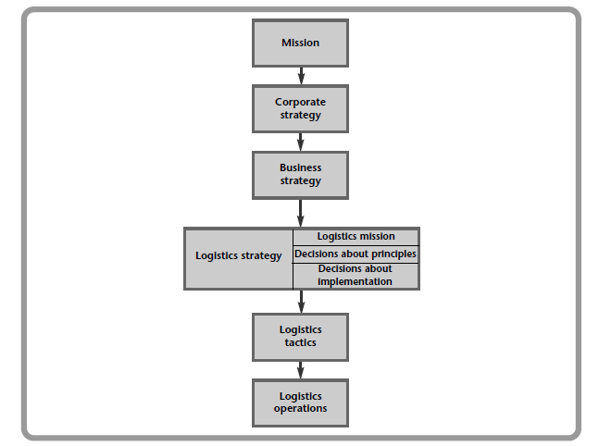
Levels of decision in logistics

Slide 56
AREAS FOR DECISIONS IN IMPLEMENTATION
Types of decision
Structure of the supply chain
Different shapes of supply chain
Location of facilities
Ownership and outsourcing
Enabling practices
Capacity

Slide 57
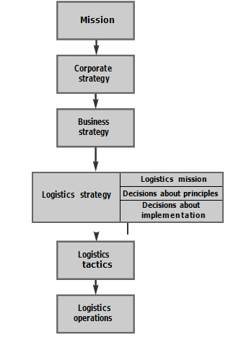
AREAS FOR DECISIONS IN IMPLEMENTATION
Types of decision

Slide 58
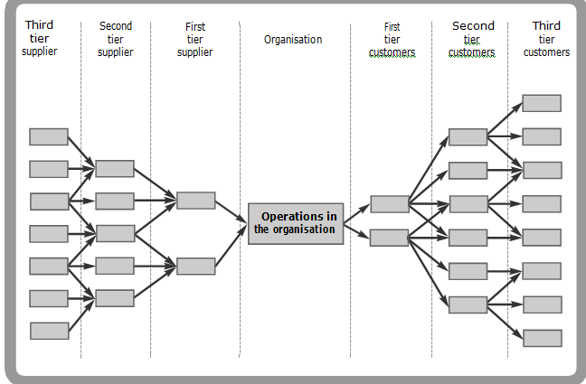
AREAS FOR DECISIONS IN IMPLEMENTATION
Structure of the supply chain

Slide 59
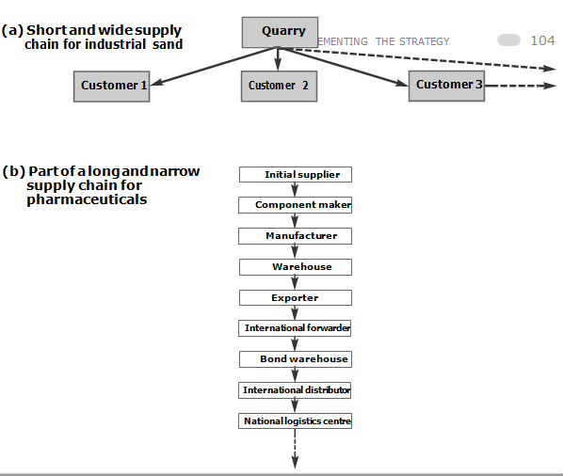
AREAS FOR DECISIONS IN IMPLEMENTATION
Different shapes of supply chain

Slide 60
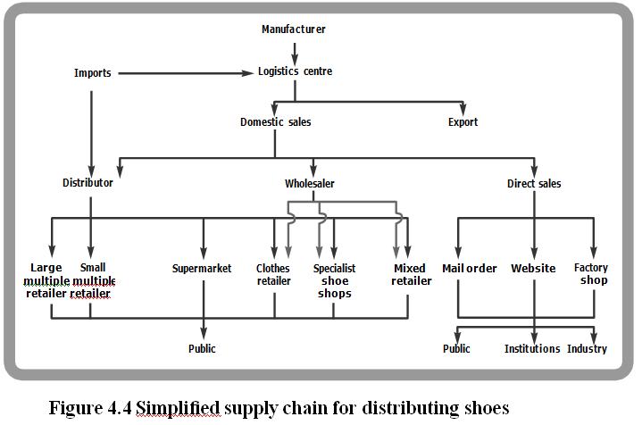
AREAS FOR DECISIONS IN IMPLEMENTATION
Different shapes of supply chain

Slide 61
AREAS FOR DECISIONS IN IMPLEMENTATION
Location of facilities
The best location for facilities depends on many factors.
A warehouse, for example, might be near to factories, customers, transport or areas with development grants. The location clearly has an effect on logistics performance.
If an organisation wants fast delivery, it will use local warehouses that are physically close to ﬁnal customers; if it wants low costs, it will concentrate stocks in large, centralised warehouses that are inevitably some distance away from customers;
if it imports and exports a lot of materials it might use warehouses near to ports or rail terminals;
if it manufactures goods, it will have a stock of ﬁnished products near the factory.

Slide 62
AREAS FOR DECISIONS IN IMPLEMENTATION
Ownership and outsourcing
An organisation can form partnerships with other companies to look after warehousing, purchase of materials, materials handling, and many of the other functions of logistics. When one company uses other companies to run its logistics, it is called third party or contract logistics.

Slide 63
AREAS FOR DECISIONS IN IMPLEMENTATION
Ownership and outsourcing
A fuller list of potential beneﬁts of outsourcing includes:
lower ﬁxed costs, with customers only paying for services they use
specialist suppliers who have expertise and use the best systems and practices
suppliers can combine work from several customers to get economies of scale
guaranteed high, and agreed, levels of customer service
ﬂexible capacity, dealing effectively with peaks and troughs in demand
lower exposure to risk from, say, varying demand
increased geographical coverage and local knowledge
a convenient way of entering new markets.

Slide 64
Disadvantages of outsourcing logistics
Of course, there are disadvantages to be set against this, such as reduced control, inability to respond to unusual circumstances, more complicated communications, conﬂicting objectives, less control over costs, and so on.

Slide 65
AREAS FOR DECISIONS IN IMPLEMENTATION
Enabling practices
Enabling practices are the activities associated with the supply chain that allow it to work efﬁciently. We might, for example, say that reliable information processing is an enabling practice that allows logistics to function properly.

Slide 66
Enabling practices
ways of managing the ﬂow of materials through the chain.
use just-in-time methods to reduce stocks,
EDI to link with partners, or procurement via websites.
use enabling practices to get a competitive advantage

Slide 67
AREAS FOR DECISIONS IN IMPLEMENTATION
Capacity
The capacity of a supply chain is the largest amount of materials that can ﬂow through it in a given time.
Not all parts of a chain have the same capacity,
If wholesaling forms the bottleneck with a capacity of 200 units of a product an hour, this sets the capacity of the whole supply chain
increase the capacity of the bottleneck;

Slide 68
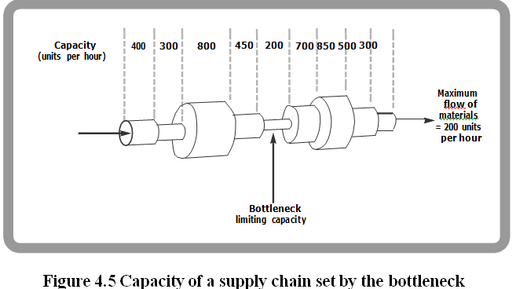
AREAS FOR DECISIONS IN IMPLEMENTATION
Capacity

Slide 69
MANAGING CHANGE
Change is inevitable
Rate of change
Business Process Re-engineering

Slide 70
MANAGING CHANGE Change is inevitable
The design of a logistics strategy is based on a range of internal and external factors. Unfortunately, these are constantly changing. Within the organisation there are changes to employees, goals, products, plans, processes, costs, suppliers, customers, and so on.

Slide 71
MANAGING CHANGE Change is inevitable
Some signs that an organisation is not changing to meet new circumstances include:
low sales and falling market share, as old products are overtaken by competitors
many customer complaints, particularly about quality and delivery dates
reliance on a few customers, especially with long-term, ﬁxed-price contracts
old-fashioned attitudes and operations
poor industrial relations, with low employee morale and high staff turnover
poor communications within the organisation and with trading partners
too much inﬂexible top management with no new appointments
inward-looking managers who are out of touch with operations or customers.

Slide 72
MANAGING CHANGE Change is inevitable
organisations need a champion, or change manager, who leads them away from their present position. This manager has the vision to see how an organisation can improve, and the ability to move it in the right direction. Unfortunately, this can be a trau- matic journey, and organisations typically move through a series of stages:5,6
Denial – where employees deny that there is a need for change
Defence – defending the current way of doing things and criticising new proposals
Discarding – beginning to move away from the old ways and towards the new ones
Adoption – using the new ways and accepting that they are beneﬁcial
Integration – assuming the new ways are normal and using them naturally.

Slide 73
MANAGING CHANGE Rate of change
One important feature of change is the rate at which it occurs. Some organisations change very quickly, such as Intel which works at the frontiers of technology and is continually devel- oping new products. Others change very slowly, and even make a virtue out of stability, such as Morgan sports cars whose basic design originated in the 1930s.

Slide 74
MANAGING CHANGE Rate of change
Major changes can be very disruptive, so organisations generally prefer a series of small adjustments. This iterative approach gives continuous improvement which is known by the Japanese name of kaizen.

Slide 75
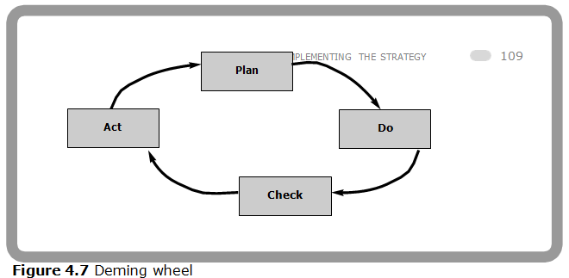
MANAGING CHANGE Rate of change
The team is continuously looking for improvements, so at this point they return to the begin- ning of the cycle, and consider more changes.

Slide 76
MANAGING CHANGE
Business Process Re-engineering
BUSINESS PROCESS RE-ENGINEERING is the fundamental rethinking and radical redesign of business processes to achieve dramatic improvements in critical, contemporary measures of performance, such as cost, quality, service and speed.

Slide 77
MANAGING CHANGE
Business Process Re-engineering
BPR does not give new methods, but it consolidates several related ideas. Some of its main principles for the supply chain are:
a supply chain should be designed across functions and allow work to ﬂow naturally, concentrating on the whole supply chain rather than the separate parts
managers should strive for dramatic improvements in performance by radically rethinking and redesigning the supply chain
improved information technology is fundamental to re-engineering as it allows radical new solutions
all activities that do not add value should be eliminated

Slide 78
MANAGING CHANGE
Business Process Re-engineering
activities should be carried out where they make most sense – information processing, for example, becomes a part of logistics rather than a separate function
decisions should be made where the work is done, and by those doing the work
you do not have to be an expert to help redesign a supply chain, and being an outsider without preconceived ideas often helps
always see things from the customer’s point of view.

Slide 79
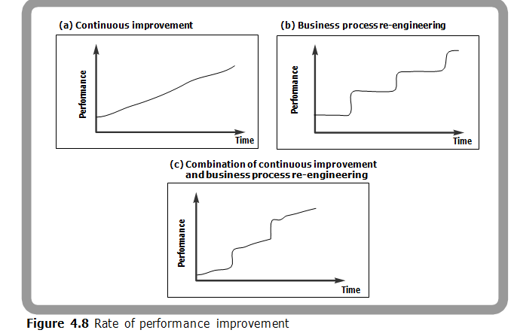
MANAGING CHANGE
Business Process Re-engineering

Slide 80
REVIEW
The logistics strategy sets the overall direction for logistics. Implementing the strategy translates this into a series of lower decisions and actions.
Unless the strategy is designed properly, implementation can be difﬁcult or impossible. To avoid these problems, managers should consider implementation during the design of the strategy, they should involve those involved in implementation, and so on.
Some strategic decisions are concerned with principles, while others are more concerned with achieving the principles. The ﬁrst of these are considered more in the design of a strategy, while the second are considered more in the implementation.

Slide 81
REVIEW
Important decisions for implementing the logistics strategy include the structure of the supply chain (length, breadth, number of tiers, type of intermediaries, and so on), location of facilities, outsourcing, enabling practices and capacity.
The supply chain must continually evolve to keep up with changing conditions. These changes can be difﬁcult, and need careful management.
An important question concerns the rate of change. Continuous improvement uses a series of small adjustments to build up a momentum for change-over time. Business process re-engineering looks for more radical changes.

Slide 82
DISCUSSION QUESTIONS
What exactly is meant by ‘implementing the logistics strategy’?
We suggested a difference between strategic decisions that set the principles for logistics, and those concerned with the practicalities of implementation. Do you think that this is a real difference? What kind of decisions ﬁt into each category?
It is often more difﬁcult to implement a logistics strategy than to design one. This is why most logistics plans fail in the practice rather than the theory. Do you think that this is necessarily true? What can organisations do to improve the implementation?
What are the main areas for strategic decisions in logistics?
Supply chains are not usually designed from scratch, but evolve over time. What prob- lems does this create? Can you suggest a better approach?
Can you ﬁnd any examples of good logistics strategies that have given poor results because of poor implementation? What could have been done better?

Slide 83
Decision Phases of a Supply Chain
Supply chain strategy or design
Supply chain planning
Supply chain operation

Slide 84
Supply Chain Decisions
STRATEGIC
TACTICAL OPERATIONAL
Procurement Manufacturing
Distribution
Logistics

Slide 85
Supply Chain Strategy or Design
Decisions about the structure of the supply chain and what processes each stage will perform
Strategic supply chain decisions
Locations and capacities of facilities
Products to be made or stored at various locations
Modes of transportation
Information systems
Supply chain design must support strategic objectives
Supply chain design decisions are long-term and expensive to reverse – must take into account market uncertainty

Slide 86
Supply Chain Planning
Planning decisions:
Which markets will be supplied from which locations
Planned buildup of inventories
Subcontracting, backup locations
Inventory policies
Timing and size of market promotions
Must consider in planning decisions demand uncertainty, exchange rates, competition over the time horizon

Slide 87
Supply Chain Operation
Time horizon is weekly or daily
Decisions regarding individual customer orders
Supply chain configuration is fixed and operating policies are determined
Goal is to implement the operating policies as effectively as possible
Allocate orders to inventory or production, set order due dates, generate pick lists at a warehouse, allocate an order to a particular shipment, set delivery schedules, place replenishment orders
Much less uncertainty (short time horizon)

Slide 88
Supply Chain Decisions
Procurement | Manufacturing | Distribution | Logistics
Supplier Selection Allocation of Suppliers to the Plants | Location, Number, Capacity of Plants What Products to Produce Which Plants to Produce them | Location, Number, Size of Warehouses | Mode of Shipment Port Selection
Procurement Policy | Warehouse Allocation Inventory Decisions Manufacturing Policy | Customer Allocation Distribution Policy | Vehicle Routing Fleet Size
 | Production Schedule Scheduling on Machines Workload Balancing | Finished Goods Inventory | Vehicle Routing

Slide 89
The Logistics Strategy Triangle (4 problem areas)
Customer
service goals
The product
Logistics service
Information sys.
CR (2004) Prentice Hall, Inc.

Slide 90
Strategic, Tactical, and Operational Decision Making
Decision area
Strategic
Tactical
Operational
Transportation
Mode selection
Seasonal equip-
Dispatching
ment leasing
Inventories
Location, Control policies
Safety stock levels
Order filling
Order
Order entry, transmittal,
Processing
processing
and processing system
orders, Filling
design
back orders
Purchasing
Development of supplier-
Contracting,
Expediting
buyer relations
Forward buying
Warehousing
Handling equipment
Space utilization
Order picking
selection, Layout design
and restocking
Facility
Number, size, and
location
location of warehouses
CR (2004) Prentice Hall, Inc.

Slide 91
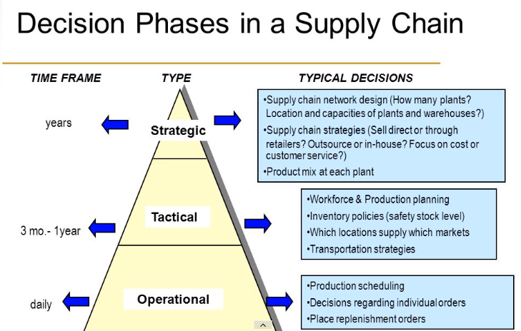

Slide 92
THANK YOU

